Slide 1

Lucky Cafe
Adam Asfour, Bence Deak, Vince Fabis, Bence Horvath, David Hegedus

Slide 2
Who did what?
Adam Asfour:
He did the Kávék/Coffee's menu .
Bence Deak:
He did the Main page.
Vince Fabis:
He did the Blog page and the Hungarian PPT.

Slide 3
Who did what?
Bence Horvath: He was all of our helper, if he got asked for help he helped/tried to help.
David Hegedus:
He did the Sütemények/Cookies page, the English PPT and he was the Group Leader .
We all did something in the CSS page.

Slide 4
Work tools
GitHub
Trello
Figma
Kréta
Visual Studio code

Slide 5

WebPage
The Main Page:

Slide 6
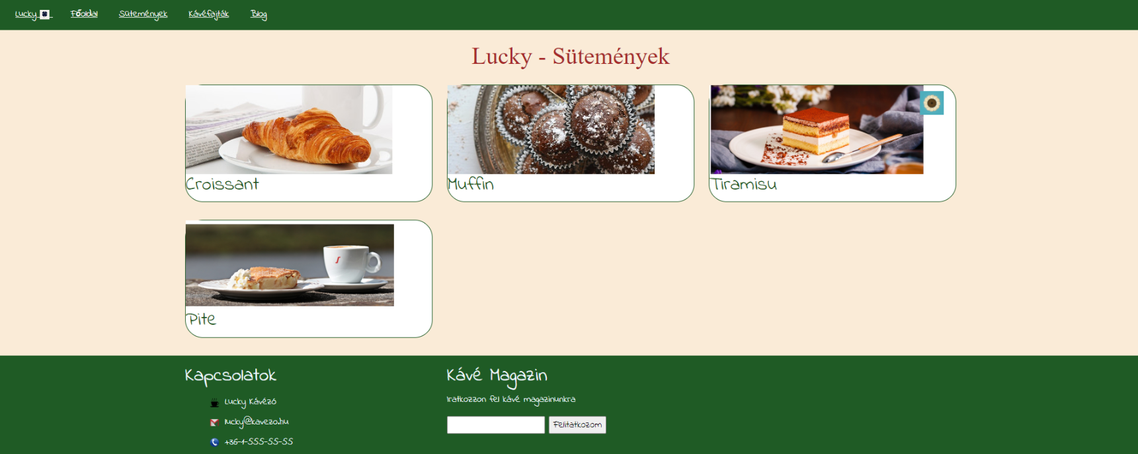
WebPage
The Cookies page:

Slide 7
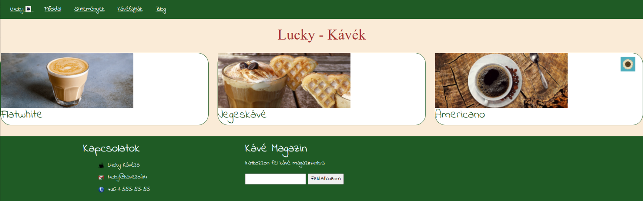
WebPage
The Coffee's page:

Slide 8
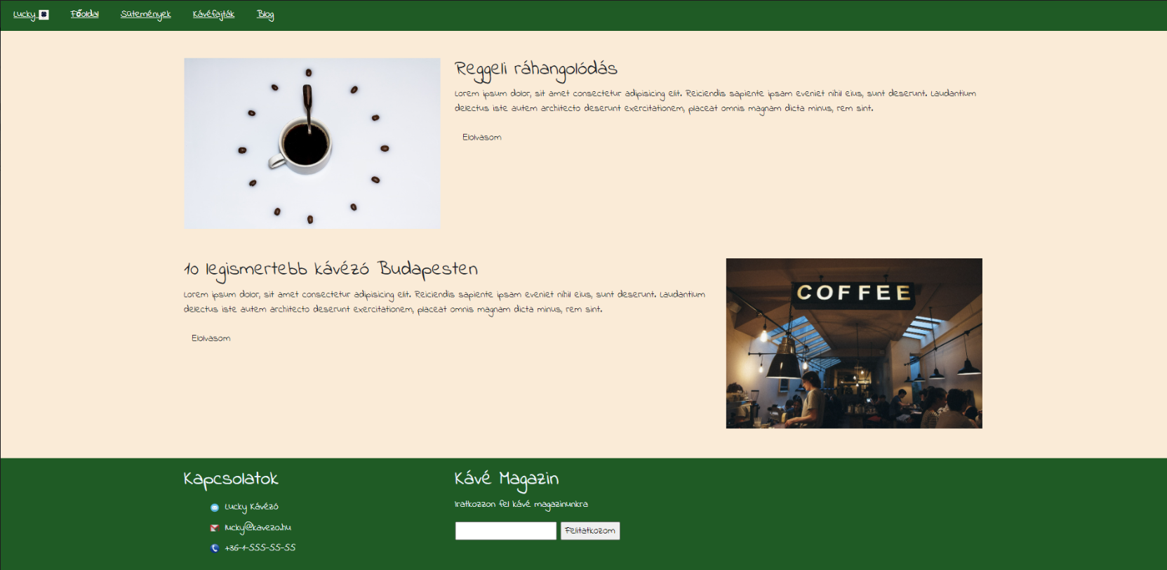
WebPage
The Blog page:

Slide 9
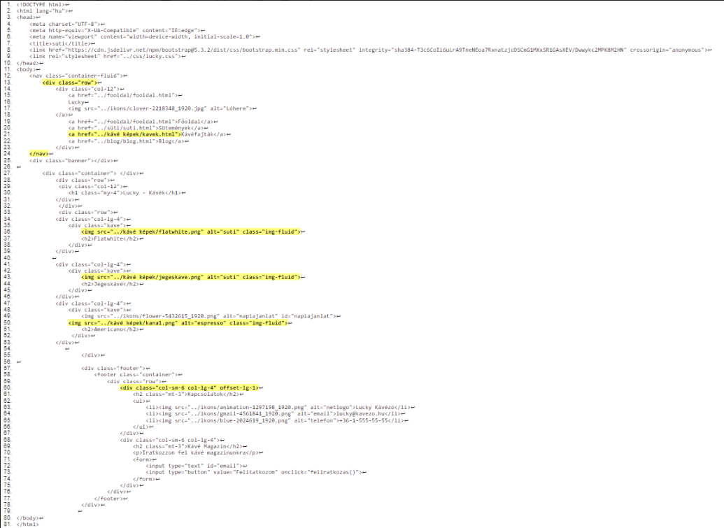
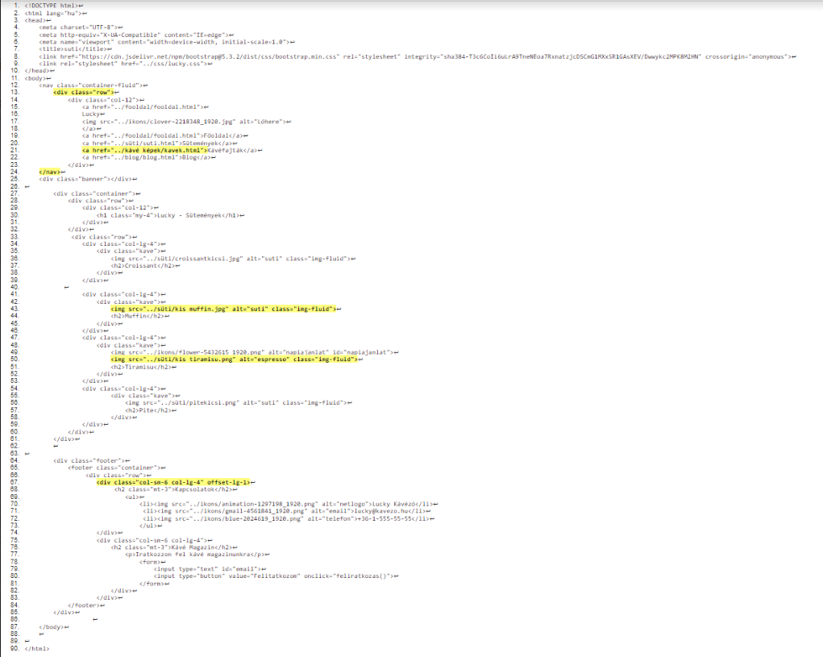
Validitation images

Slide 10
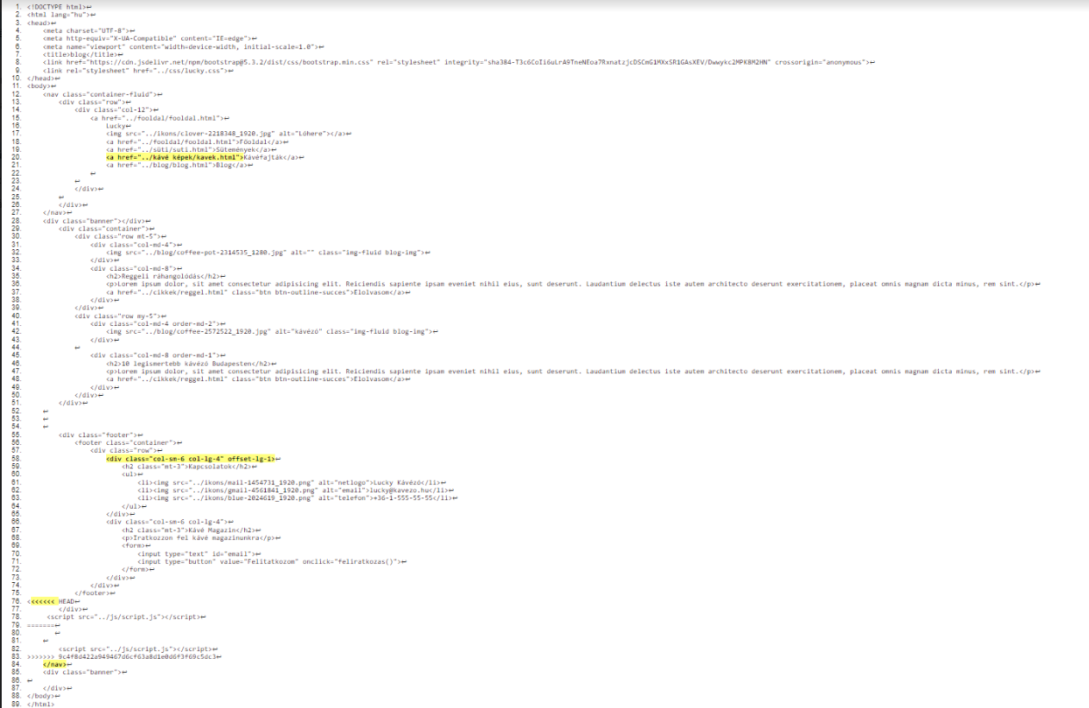
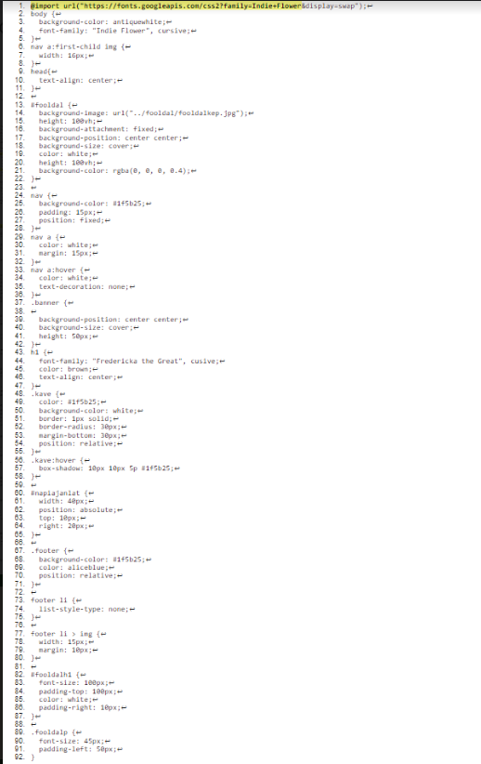
Validitation images

Slide 12
Thank you for your attention!

